Slide 1

Remittance Flows – The Economic Lifeblood
The Global Link: Analyzing the billions of dollars flowing from overseas workers back into the local economy.
Impact Analysis: Correlating remittance peaks (e.g., before Eid) with local inflation and retail growth.
Forecasting: Predicting future currency inflows to help local businesses plan inventory and expansion.

Slide 2

Microfinance & Alternative Credit Scoring
The Gap: Small business owners in rural areas often lack formal bank statements or credit histories.
Data-Driven Trust: Using alternative data (utility bill consistency, mobile phone usage, supplier references) to build "Credit-worthiness" models.
Financial Inclusion: How data science enables interest-free or micro-loans for the "unbanked" population.

Slide 3
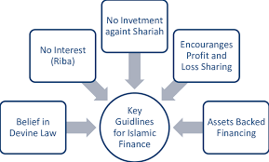
Islamic Finance – The Logic of Profit-Sharing
Shariah-Compliance: Moving from Interest (Riba) to Profit-Loss Sharing (Mudarabah/Musharakah).
Data Structuring: How to build systems that track project performance and distribute profits proportionally rather than using fixed percentages.
Transparency: Using data to ensure equitable distribution of risk and reward between the financier and the entrepreneur.

Slide 4
Mobile Wallet Analytics (The Fintech Frontier)
Ubiquity: Analyzing the massive adoption of services like EasyPaisa and JazzCash.
Pattern Recognition: Identifying usage trends (e.g., bill payments vs. P2P transfers) across different age groups.
Fraud Detection: Using anomaly detection to spot suspicious transaction spikes or "Social Engineering" scams in real-time.

